Slide 1
NHANES Data Exploration and Cardiovascular Risk Prediction
Cody Johnson

Slide 2
Introduction
Cardiovascular disease (CVD) causes 31% of all deaths worldwide, making it the leading cause of mortality worldwide
Simple, personalized risk prediction can empower individuals to make informed health choices and develop an introductory understanding of their health risks before going to the doctor.

Slide 3
Idea and Purpose
The main objective is to build a simple calculator to help individuals assess CVD risk based on known health indicators, this will help users:
Understand their modifiable and unmodifiable CVD risk factors
Promote health literacy by showing simple visualizations showing leading causes of CVD
Provide resources and actionable insights for reducing CVD risk

Slide 4
Data Source, NHANES
NHANES (National Health and Nutrition Examination Survey) is a dataset revered for its data quality, comprehensiveness, sample size, and for remaining free for public use.
Namely for our sake, it contains extensive questionnaire data relevant to CVD risk factors.

Slide 5
Data Selection
Upon searching through the many variables offered through NHANES I conducted a brief literature review to determine relevant risk factors. I’ve settled on the below initial variables since they are self reported, an individual could easily measure them at home, and they all have proven ties to heightened CVD risk:
Demographics: Age, gender, ethnicity.
Body Measures: Height, waist circumference, and derived waist-to-height ratio.
Behavioral Factors: Physical activity, sedentary behavior, smoking habits, diabetes status.

Slide 6
Data Dictionary
Age: Age of the respondent in years. (0-80)
Sex: Sex of the respondent. (Male, Female)
Ethnicity: Race/ethnicity of the respondent.
Height: Height of the respondent in centimeters.
Waist: Waist circumference of the respondent in centimeters.
Total active minutes: Total minutes of moderate and vigorous physical activity per week.
Total sedentary minutes: Total minutes spent in sedentary activities per day.
Smoking: Lifetime smoking history. (1 = Smoked at least 100 cigarettes in life, 2 = No)
Diabetes: Doctor-diagnosed diabetes (1 = Yes, 2 = No, 3 = Borderline).
Cardiovascular Disease (CVD): Binary variable indicating the presence of any self reported history of cardiovascular disease:

Slide 7
Data Cleaning
Although NHANES is well revered for its data quality, there were many key variables that had high data missingness. Across ~12,000 datapoints, 7 of the key variables had at least 3,000 missing values
Additionally, the data structure made it very time consuming to generate the combined dataset containing all key predictor variables and the CVD response variable

Slide 8
Model Selection
A random forest model was selected due to its combined ability to inherently handle high missingness, accuracy, handle non-linear relationships, and to potentially extract feature importance.

Slide 9
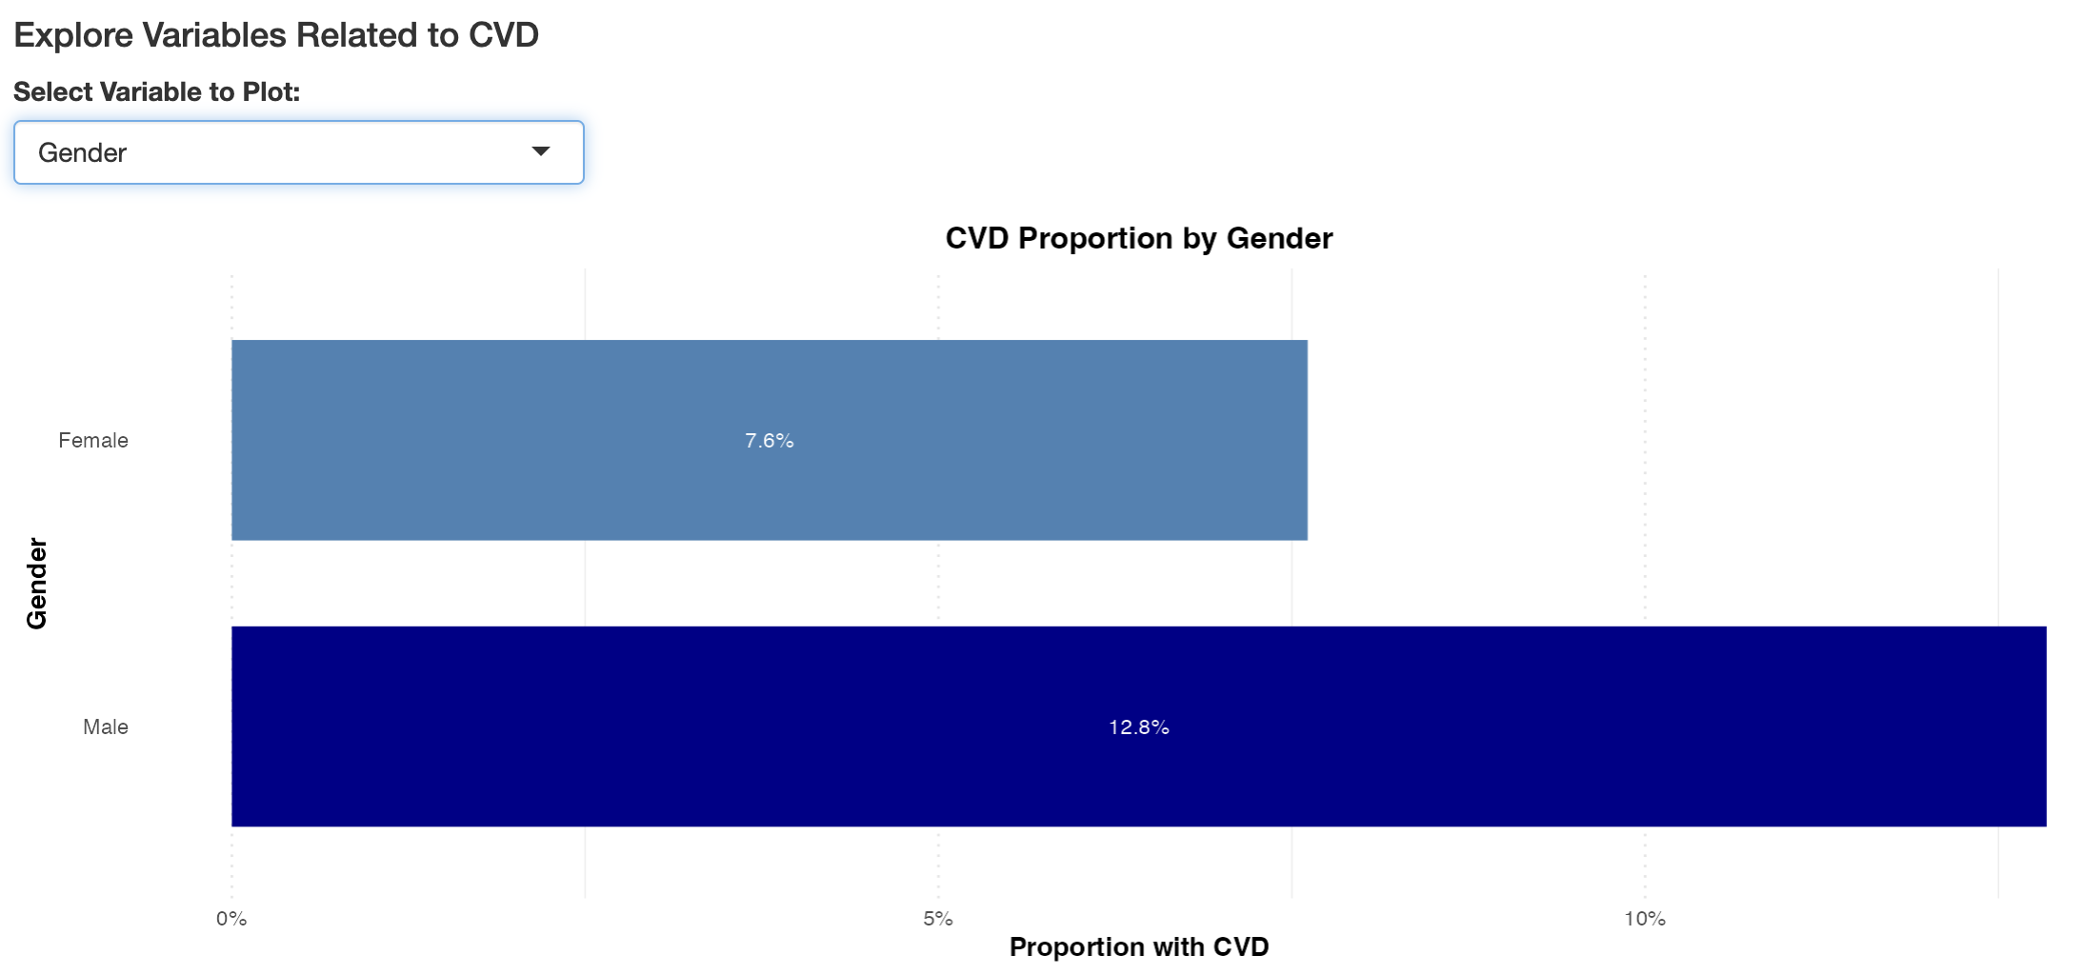
Generating Visualizations (Categorical)
Simple bar plot visualizations were chosen to highlight the distinct differences in CVD risks by the categorical variables

Slide 10
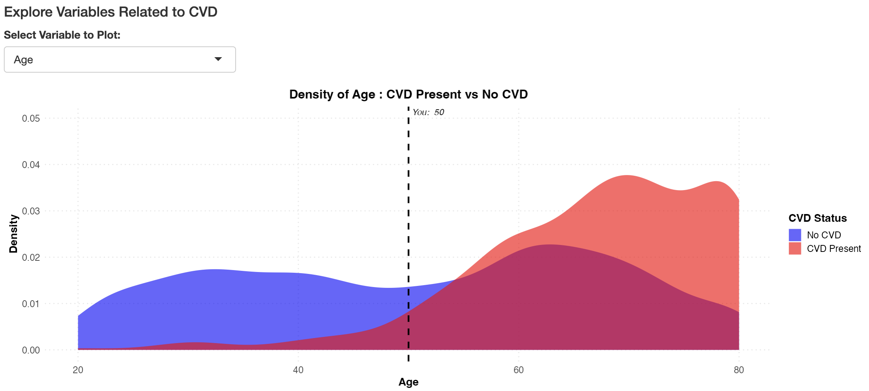
Continuous Visualizations
Similarly, fluid density plots were chosen to highlight the differences in CVD risk across continuous variables such as age seen below, with a dynamic marker highlighting the users selected input

Slide 11
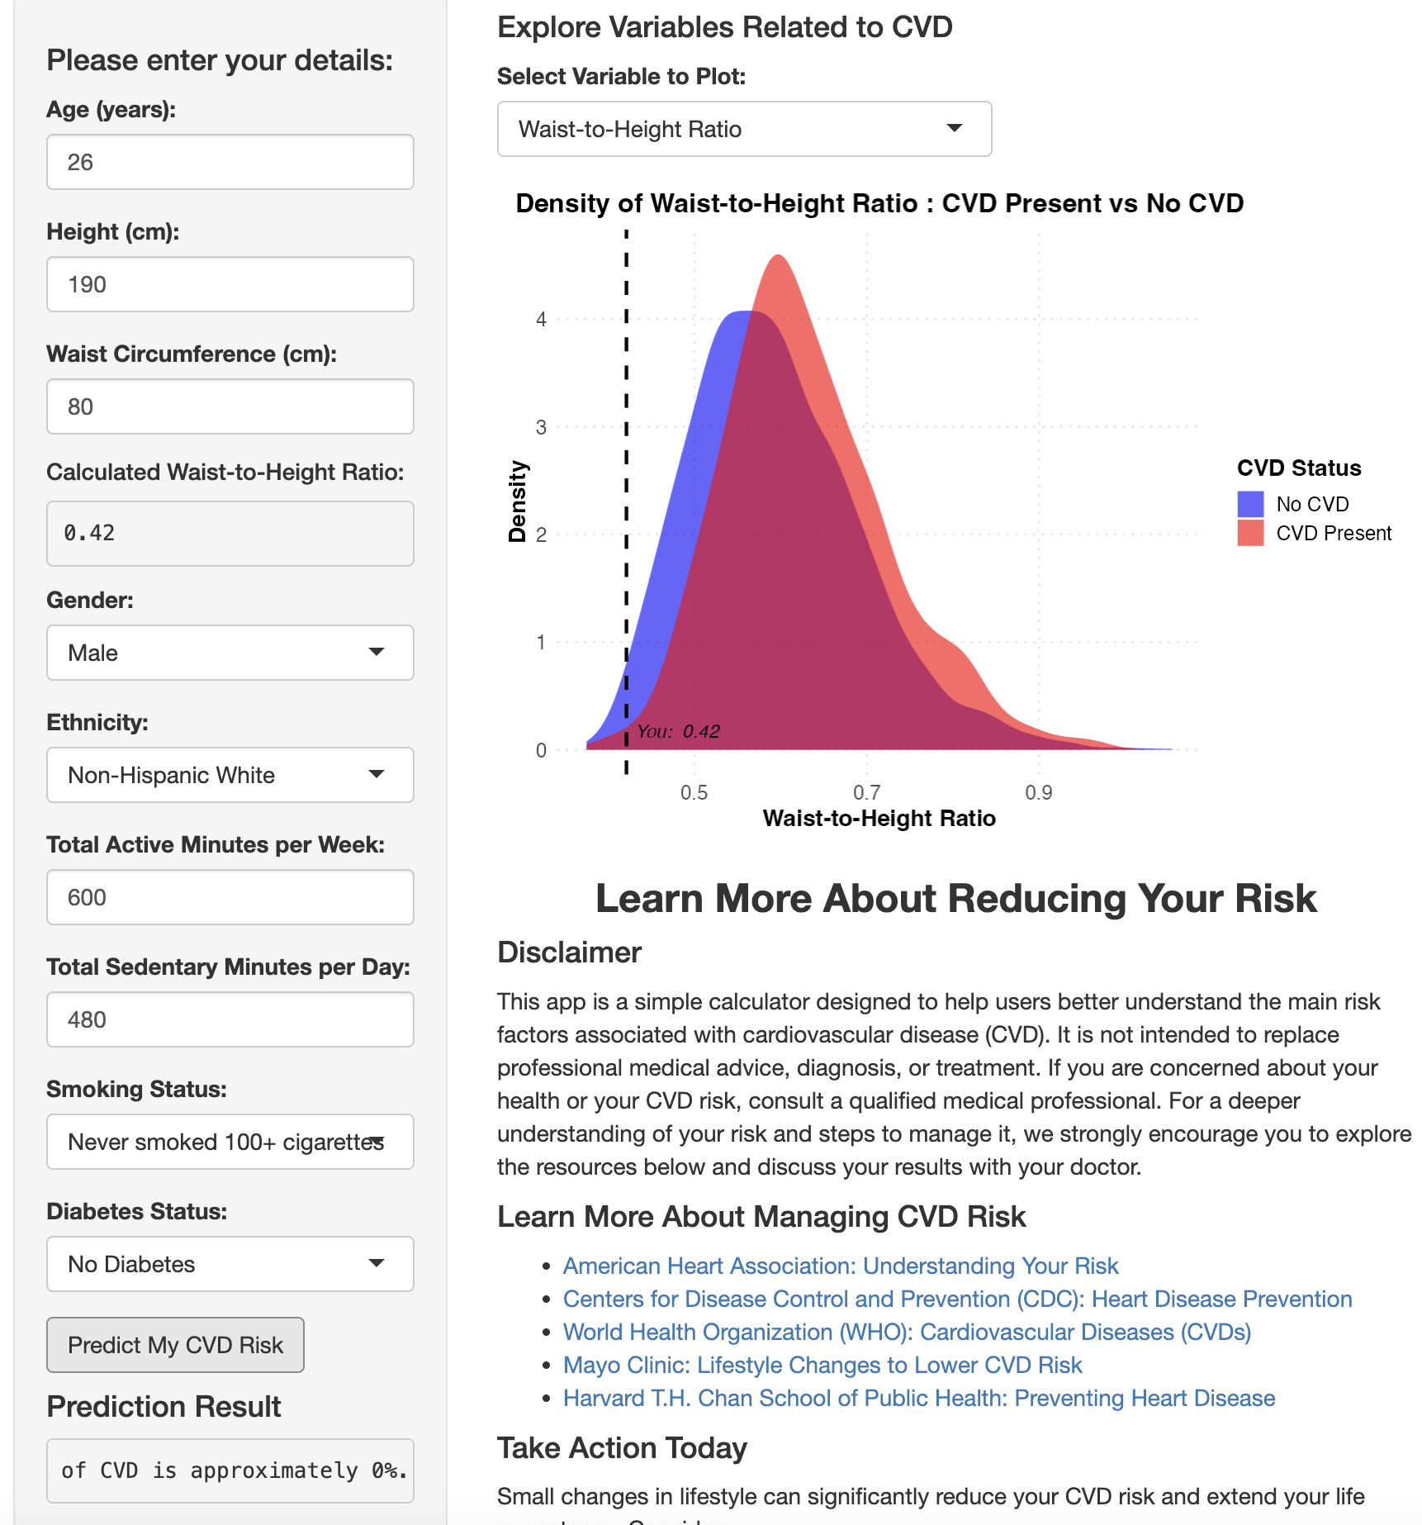
Finished R Shiny App
The finished app was designed to be simplistic, and emphasis was put on reminding the user this is not a statistically sound calculator and to consult their doctor and explore further online to better understand their heart health
https://github.com/CodyTrainsData/shiny-cvd-app

Slide 12
Skills learned
How to create a Shiny App using R
Deploying a project using GitHub
Saving off a trained model
App Debugging

Slide 13
Primary Challenges, Data
The dataset left a lot to be desired, namely in the large amounts of missing data, and the fact that many of the variables were self reported.
Self reported physical activity is seemingly random and likely overreported, while alcohol consumption is likely underreported
There were no correlations between blood pressure and risk for CVD, leading me to believe there are even more serious underlying issues in the integrity of this dataset
Survivor bias due to only sampling those who have had a heart condition and survived

Slide 14
Challenges in this simple app
The point of this calculator was to have individuals understand their risk factors without going to a doctor’s office to retrieve samples, blood pressure, or an MRI, limiting the quality data we could use to create a model.

Slide 15
Future Directions
This app could be greatly improved with a higher quality longitudinal dataset tracking individuals on these 8 metrics and noting individuals who have passed from CVD.
Confidence intervals could be added to the percentage risk to help individuals understand that no single number can be determined for their risk based on these risk factors.
Individuals could track their metrics on this app and then save off their data to bring to their doctor to discuss.

